Slide 1
Understanding of the Problem and Data
Homesite, a leading provider of homeowners' insurance, is looking for a dynamic conversion rate model that can give them confidence that a quoted price will lead to a purchase.
The data provided to us seem to consist of various features related to Coverage, Geographic Details , Personal Details and Sales details
Additionally, the training data set has only 65K records, whereas the set to be predicted has got about 178K records. So, in a way we are trying to predict using 1/3rd of the historical data.
Also, the problem here is again an imbalanced one, like the other two problems of previous assignments, with about 20% of cases with homeowners purchasing the insurance plan and the rest 80% cases of non purchasing

Slide 2
Approaches Used
Birds Eye View:
Individual Classifiers
Stacked(Ensemble)
Both these types having the default and hyper parameter tuned models.
In order to improve the accuracy of the predictions in Stacking, I have used SMOTE technique to pump in synthetic data for the minority class.

Slide 3
Individual Models Used
Decision Tree Classifier
Random Forest
Gradient boosting
Multi-Layer Perceptron
Support Vector Machine
K Nearest Neighbor

Slide 4
Models Used with Stacking
Before Stacking, I have used SMOTING technique to create synthetic data for the minority class of “1” in the training data
Based on SMOTE data, use the below models for stacking:
Within the layers of Stacking, I used the below classifiers
Decision Tree,
Random Forest
Gradient Boosting
To predict the Test data based on Stacking, I used
Gradient Boosting
Multi layer Perceptron
Support Vector Machine
K-Nearest Neighbor

Slide 5
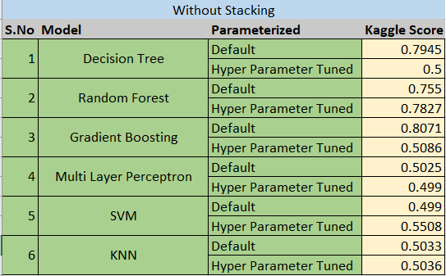
Kaggle Scores for Individual Models

Slide 6
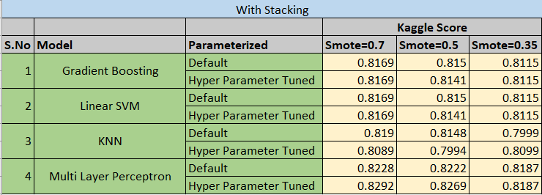
Kaggle Scores for Stacked Models

Slide 7
Observations based on Scores
Kaggle Scores for Stacked models seem to be higher for the Stacked models compared to the individual models, implying that the overall accuracies of Stacked models are higher compared to that of individual models.
For stacked models, a SMOTE value of 0.35 results in slightly lesser Kaggle scores, compared to that of a SMOTE value of 0.5. Similar is the case with the SMOTE value of 0.7 and 0.5. Meaning that the more is the data available for the minority class, better are the accuracies of prediction.

Slide 8
Learning 1
One of the fundamental problems -- was with respect to imbalanced data sets.
Accuracies are more but the Confusion matrix results in more of false positives and false negatives, and relatively fewer true positives.
One of the ways to do this is by increasing the minority class to some random big number and the other way is to reduce the majority class elements.
But either of these methods create an imbalance:
With respect to what random big number would result in an accurate prediction
Reducing the minority class will reduce the number of cases of prediction for majority class
SMOTE, an oversampling technique, helps increasing the counts of minority class by pumping synthetic data as a ratio of majority class.
SMOTE is supposed to be a better way compared to the other two approaches

Slide 9
Learning 2
Other Aspects we learned are MLPs, SVMs and KNNs
MLPs or Multi-Layer Perceptron’s are a class of Artificial Neural Network models.
As the name goes by, between the inputs and the output/final predictions, we have multiple layers of perceptron's.
Each input is passed on to each individual processor where in each processor extracts a feature from the input.
Weights are assigned to each of the inputs so that the predictions are based on the weighted input value, unlike completely on the majority vote.

Slide 10
Learning 3
SVM, also called Support Vector Machine, is a method of learning used to categorize the data using a Hyper plane.
There could be many hyper planes we can draw to categorize and separate, but the key aspect is to find those points or vectors that are near the hyper plane that allow a fat plane of separator
KNN, also called K-Nearest Neighbor, is a method of lazy learning where in we identify the category of a point in the plane based on the nearest neighbors. We defined the number of nearest neighbors to look for, to categorize.

Slide 11
Learning 4
The other learning we have is with respect to Stacking.
Here, instead of using individual classifiers separately, we use a set of classifiers as an ensemble in the Stacking. We generally take multiple layers of ensemble methods.
The output we get will be a set of predictions from each of these classifiers.
Using this training set of predictions, we train the classifiers in the subsequent layers and eventually get another set of predictions.
The predictions of the target from each of these classifiers and the final target of the training set is used as a training set for the final test data to predict the target.

Slide 12
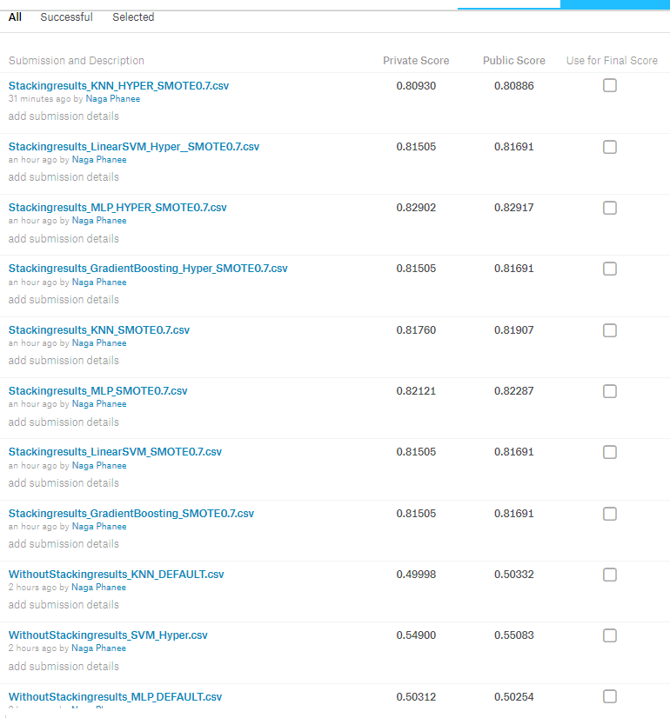
Screenshots of Kaggle Scores

Slide 13
Thank You!

